Slide 1
COMMUNICATING WITH
YOUR CONSTITUENTS
Cindi meche, co-chair
Theresa Sherman, member
Communications and Marketing committee

Slide 2
Communications & Marketing Committee
Who are we?
The Staff Council Communications and Marketing Committee develops communications and marketing strategies to further the mission and goals of Staff Council.
Develop marketing materials and collateral for Staff Council Events & Activities
Liaison with members of UCAM for assistance with broad University-wide communication efforts
Provide guidance to the Council on communication and marketing policy

Slide 3
What is my role?
When communicating with the Staff Council, you are representing your constituents
It may be helpful to ask them what they think about upcoming resolutions or actions
When communicating with constituents, you are representing the Staff Council
They want to know what you are doing, and how the Council is helping them

Slide 4
What are the most important things that happen at Staff Council meetings?
Actions: Resolutions, formation of committees, etc
Reports: Information from officers, committees
Guest Speakers: Information of relevance to staff
Comments: Events and other news from constituents and councilors

Slide 5
How Often?
Minimum once per month after Business Meeting; Additionally, you may want to communicate out:
To introduce yourself! (Brief bio and your reason for wanting to serve as their representative)
When you are seeking feedback on an upcoming resolution or action
Any special events, deadlines or situations that may arise
Holiday greetings

Slide 6
What should I share?

Slide 7
What should I share?
Information about action taken at the Staff Council meeting – if it will be in the minutes, it is safe to share. Examples: resolutions, things we voted on, reports received in writing
Information about upcoming Staff Council events, or UNM events for staff discussed at Council meetings

Slide 8
What should I share?
Messages approved or distributed by the Staff Council Administrator, President, President-Elect, or Speaker
You can also request feedback from your constituents on upcoming Council activities, like resolutions, committees, and/or events

Slide 9
What shouldn’t I share?
Use caution if: the person sharing the information mentions the news isn’t out yet, or something is still under consideration/no action was taken.
Be mindful of personal opinions or influencing actions.
OK
“This event is a great opportunity to let your legislators know your position on UNM issues of funding and compensation.”
NOT OK
“Go send postcards to your legislators and tell them they need to pay us more!”

Slide 10
What shouldn’t I share?
Listservs
You CANNOT use the listserv to:
Promote non-UNM events or personal projects
Campaign for elections
Influence political or other activity
Communication Best Practices:
Remember, your communications reflect on the University as a whole.
Take the conversation offline.

Slide 11
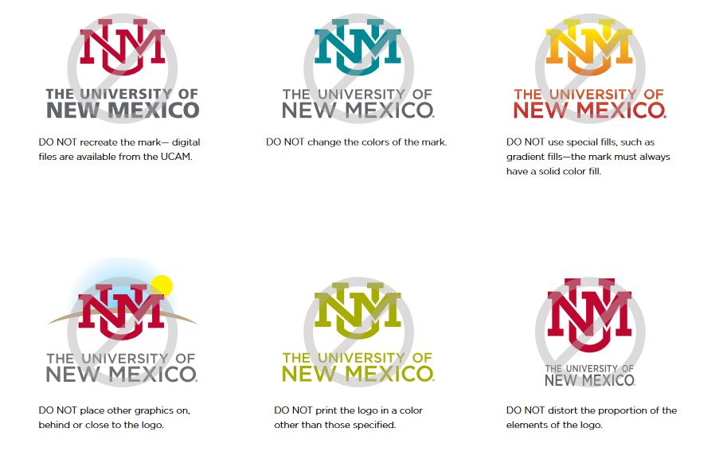
Logo Usage & UNM Brand Guidelines
Using a UNM logo in your communications? Remember:
Check with your Logo Liaison or visit:
brand.unm.edu

Slide 12
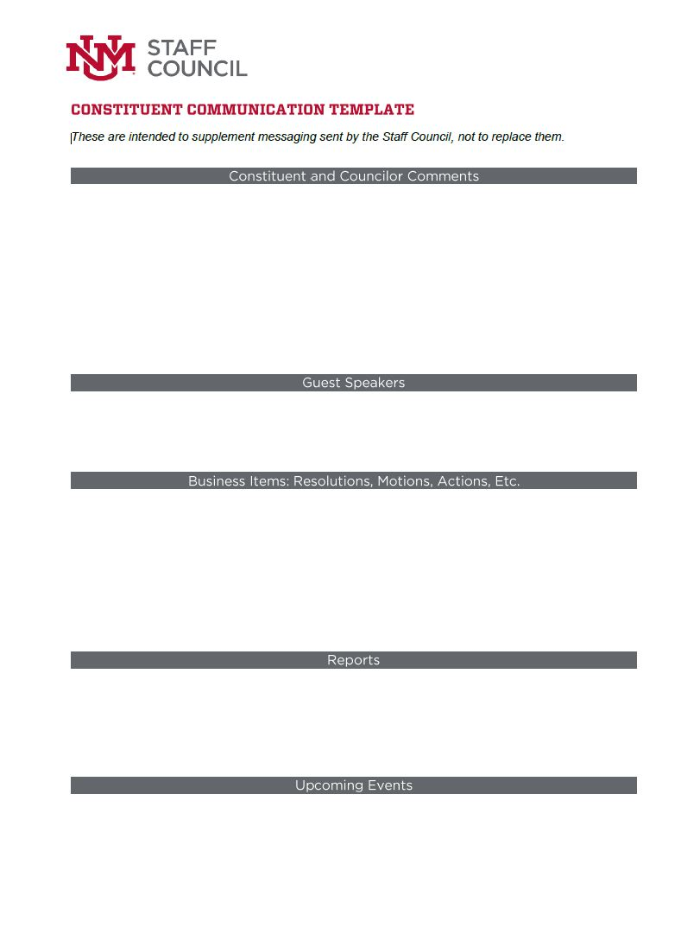
Resources
Staff Councilor Resources Website
Communications and Marketing Policy
Communications and Marketing Quick Reference Guide
Email Amy: scouncil@unm.edu
Email the C&M committee chairs:
Mark Reynolds: reynolds@unm.edu
Cindi Meche: cmeche@salud.unm.edu

Slide 13
Don’t Speak the Language of Robert’s Rules?
2020 Smart Meetings Workshop (Virtual)
Saturday, June 27, 8:30 a.m. to noon
Appropriate for all levels of experience
Registration Deadline: June 24
https://nmsap.org/pdf/2020_Smart_Meetings_Online.pdf
SC Communication and Marketing Committee can provide funding for a limited number of councilors to attend!
Contact Amy Hawkins if you are interested.
Notes:
https://nmsap.org/index.php/smart-meetings

Slide 14
Thank you for Serving
Your UNM Constituents!
Any questions?

